Slide 1

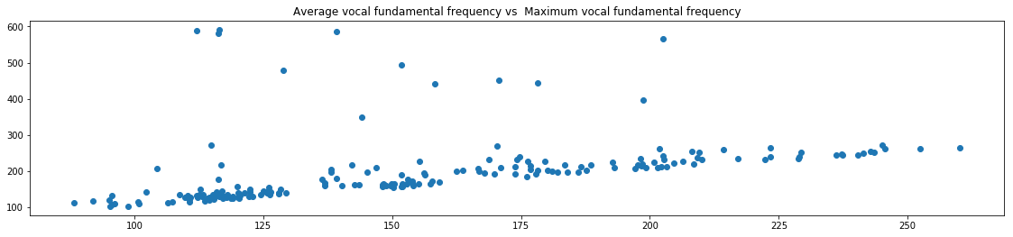
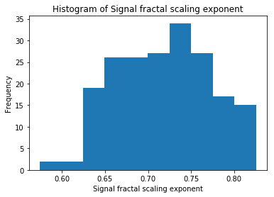
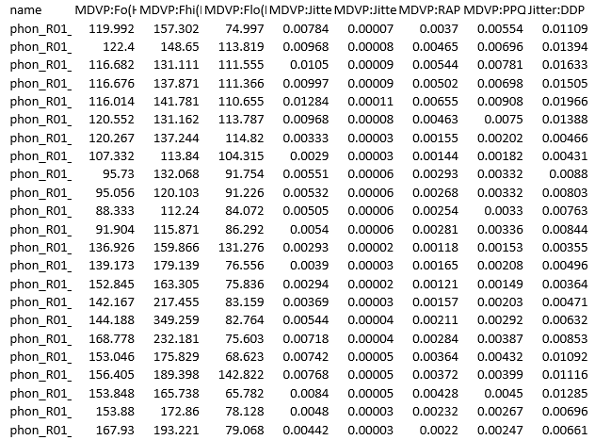
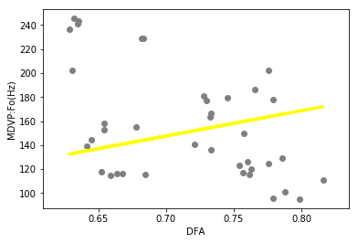
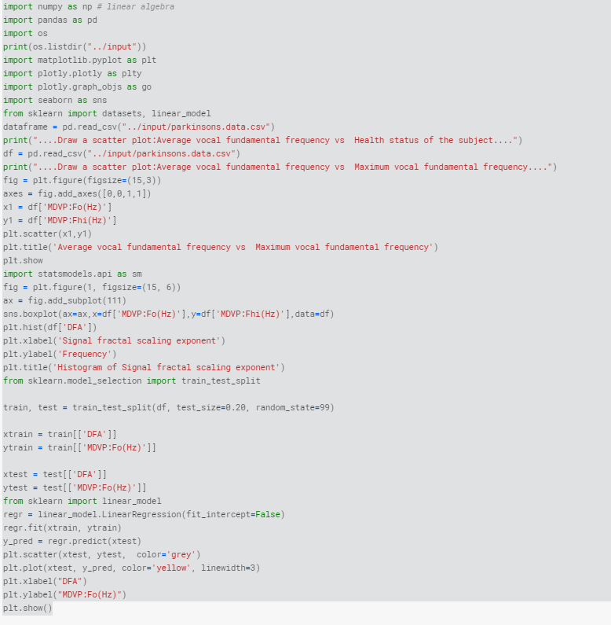
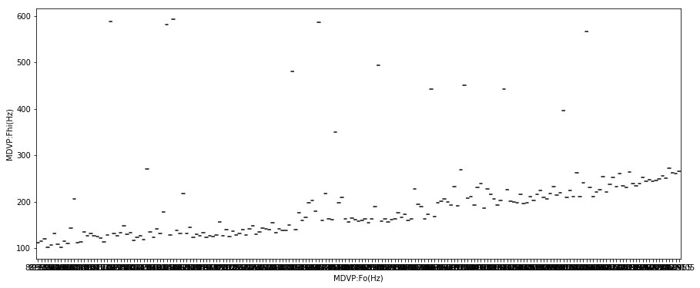
Graphical Representation on Parkinson’s Patient Experiment
IPE-205 Poster Submission
Submitted To:
Assistant Professor Tanmoy Das
Submitted By : 201736021,201736022, 201736027,201736047
Datasets
Summery of the datasets
This dataset is composed of a range of a biomedical voice measurements of 31 people,23 with Parkinson’s disease. Each column in the table is a particular voice measure and each row corresponds one of 195 voice recording from these individuals ("name" column). The main aim of the data is to discriminate healthy people from those with PD, according to "status" column which is set to 0 for healthy and 1 for PD.
Python Coding
Scatter Diagram
Reference
The dataset was created by Max Little of the University of Oxford, in collaboration with the National Centre for Voice and Speech, Denver, Colorado, who recorded the speech signals. The original study published the feature extraction methods for general voice disorders.
Boxplot
Regression analysis

